Slide 1
Introduction to translation
Transformations

Slide 2
how to use Oak lessons

Slide 3
I can understand the nature of a translation and appreciate what changes and what is invariant.

Slide 4
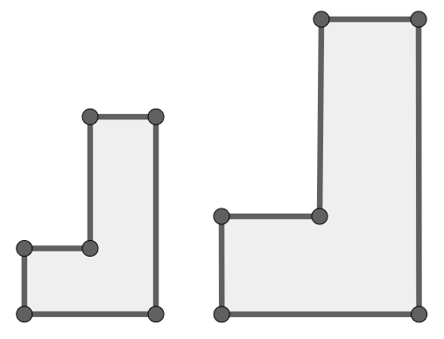
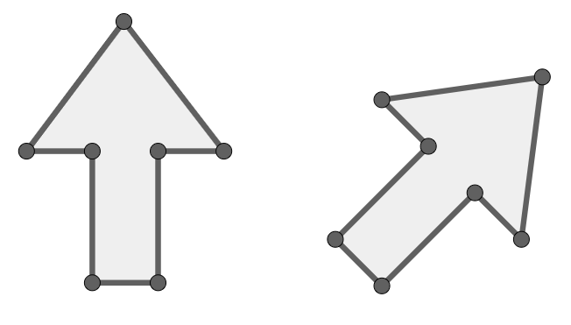
If one shape can fit exactly on top of another using rotation, reflection or translation, then the shapes are congruent.
A
F
A
A
A
F
B
B
G
C
C
B
C
F
C
B
D
F
G
D
E
E
D
E
D
E
Example of orientation changing
Example of orientation not changing

Slide 5
Translation is a transformation in which every point of a shape moves the same distance in the same direction.

Slide 6

Introduction to translation
Translation
Orientation and position of the image

Slide 7
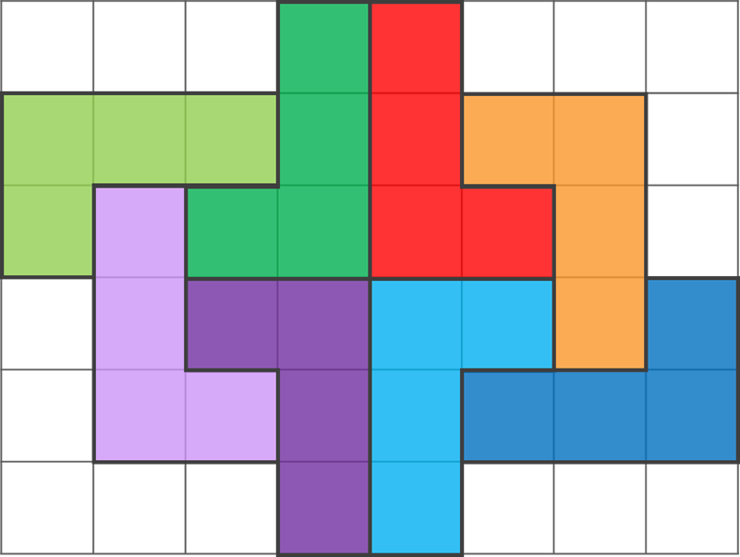
Translation
All of the L shapes in the figure are congruent.
If you could cut them out individually you would be able to put one exactly on top of another.
You may need to turn them over, or twist them around but you can stack them up.
B
C
A
D
E
F
G
H
Which of the L shapes can be slid (without turning or flipping) onto each other?

Slide 8
Translation
In this figure, there are 2 pairs that have been translated.
B
C
C could slide onto E, without flipping or twisting.
F could slide onto D, without flipping or twisting.
A
D
E
F
G
H

Slide 9
Translation
A translation is a type of transformation.
When a translation takes place, the object is moved to create its image.
If the image and object are not congruent then it cannot be a translation.

Slide 10
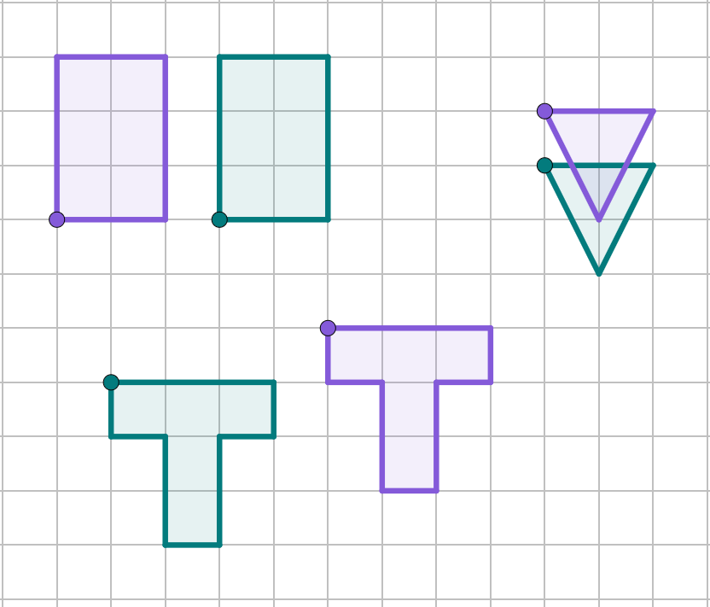
Translation
Examples of translated objects
N
N′
A
A′
P
P′

Slide 11
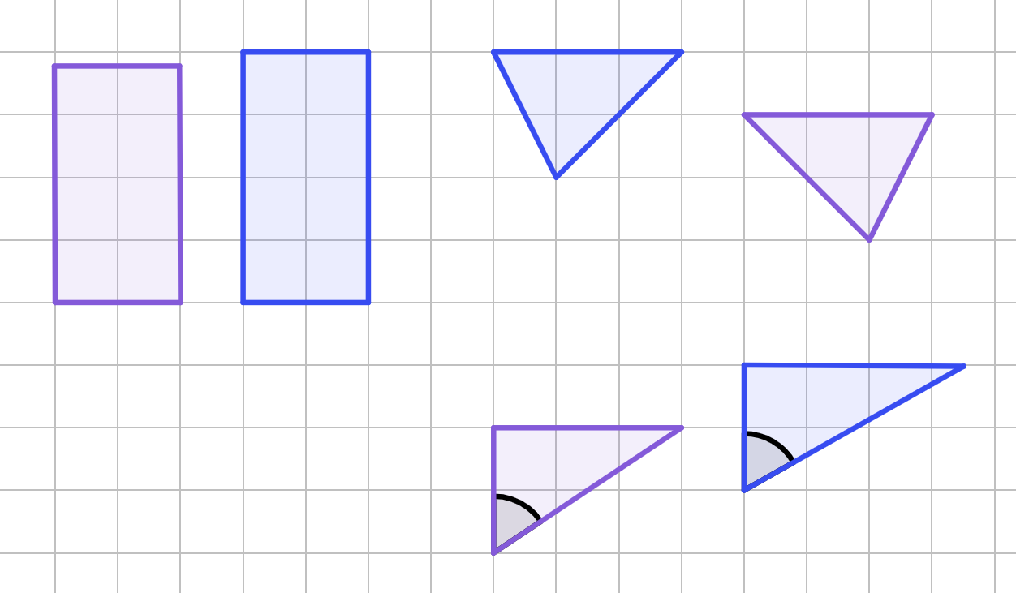
Translation
Non-examples of translated objects
60°
56°

Slide 12

Translation
To be a translation, the image must be …
… a different size to the object.
… congruent to the object.
… a different orientation to the object.

Slide 13
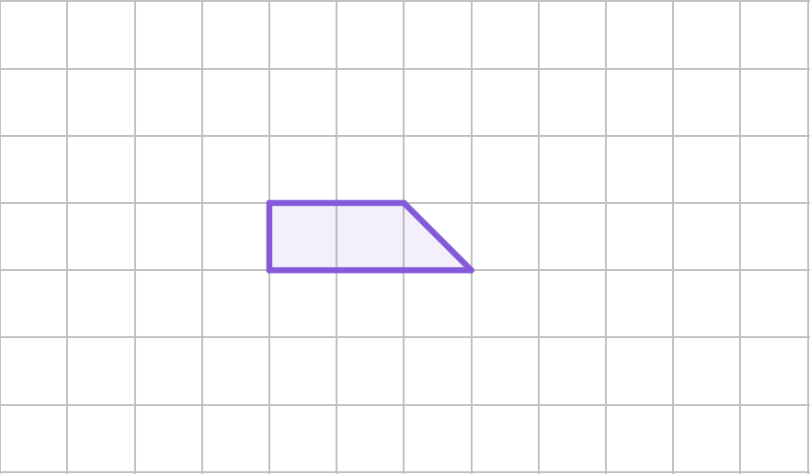
Translation
Draw four more copies of the shape so that they could be a translation.

Slide 14
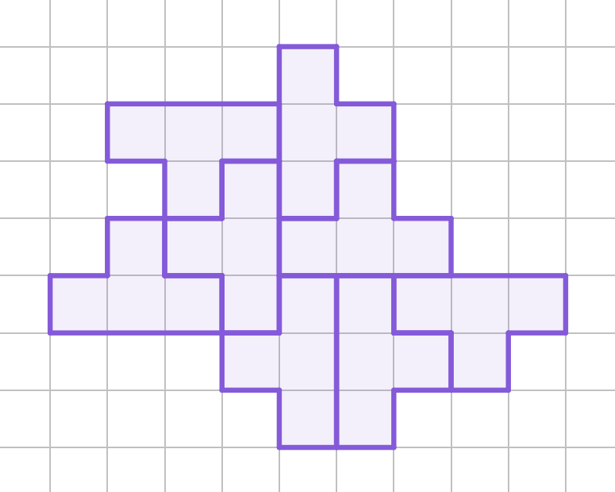
Translation
Write down the pairs that are a translation of each other.
A
B
C
D
E
F
G
H

Slide 15
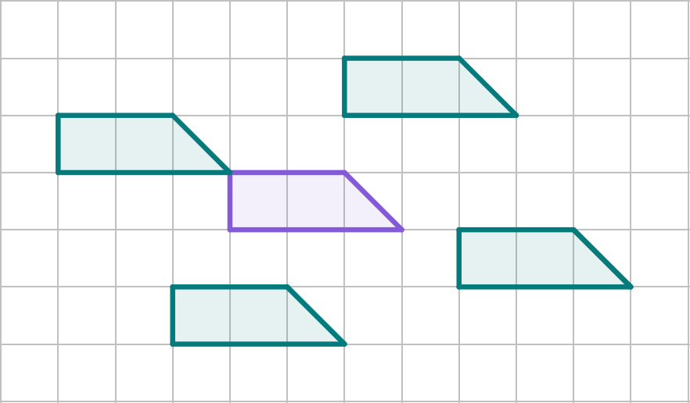
Translation
Draw four more copies of the shape so that they could be a translation.
Example of four you may have drawn.

Slide 16
Translation
Write down the pairs that are a translation of each other.
A
B
A and F
B and H
C and G
D and E
C
D
E
F
G
H

Slide 17
Introduction to translation
Translation
Orientation and position of the image

Slide 18
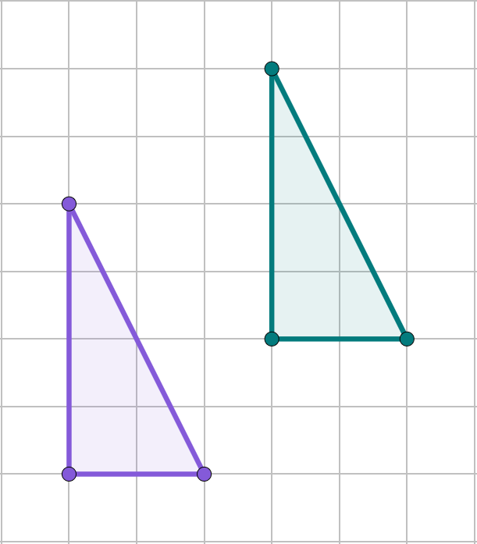
Orientation and position of the image
The object and image are congruent if a translation has taken place.
A′
A
B′
C′
B
C

Slide 19
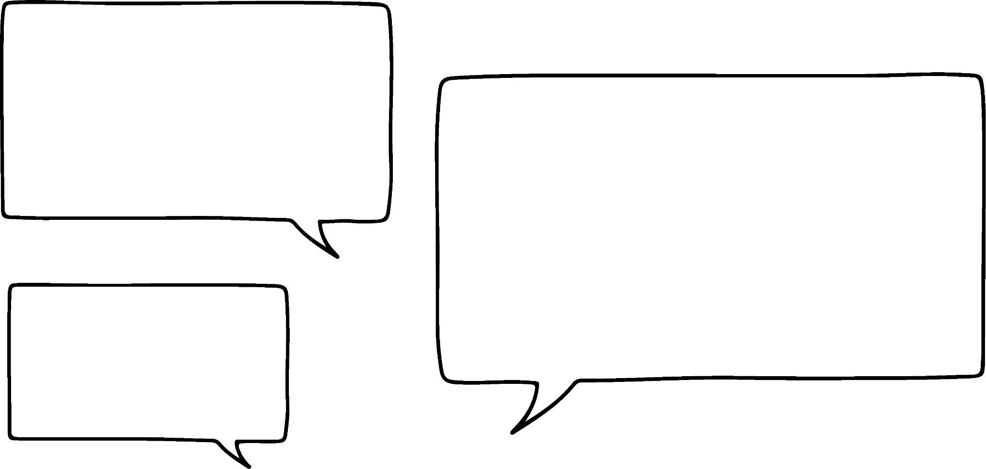
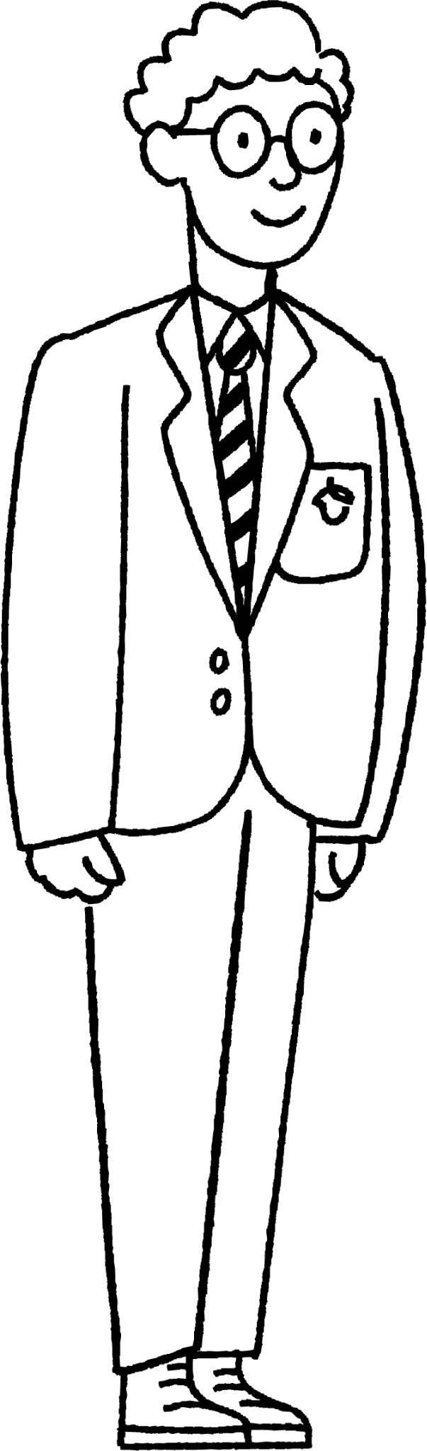


Orientation and position of the image
My shape is congruent to yours, so it is a translation.
It cannot be.
You cannot slide one on top of the other completely.
Lucas
Alex

Slide 20


Orientation and position of the image
My shape is congruent to yours, so it is a translation.
It cannot be.
You cannot slide one on top of the other completely.
Lucas
Aisha

Slide 21
Orientation and position of the image
The object and image are congruent if a translation has taken place.
The image will not be mirrored if a translation has taken place.
The image will have the same orientation as the object.

Slide 22
Orientation and position of the image
When an object is translated what changes and what is invariant?
Property | Changed - yes/no?
Lengths
Angles
Mirrored
Orientation
Position
No
No
No
No
Yes

Slide 23
Orientation and position of the image
Complete the following statement.
The only property that isn’t invariant when a translation is completed is .
position

Slide 24
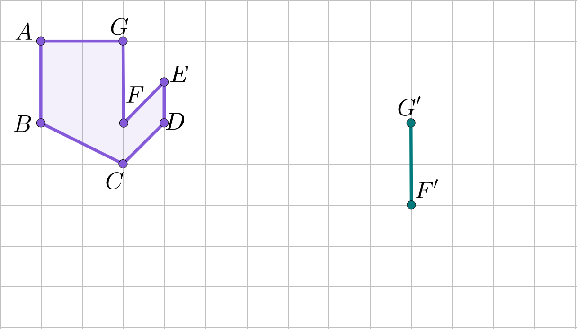
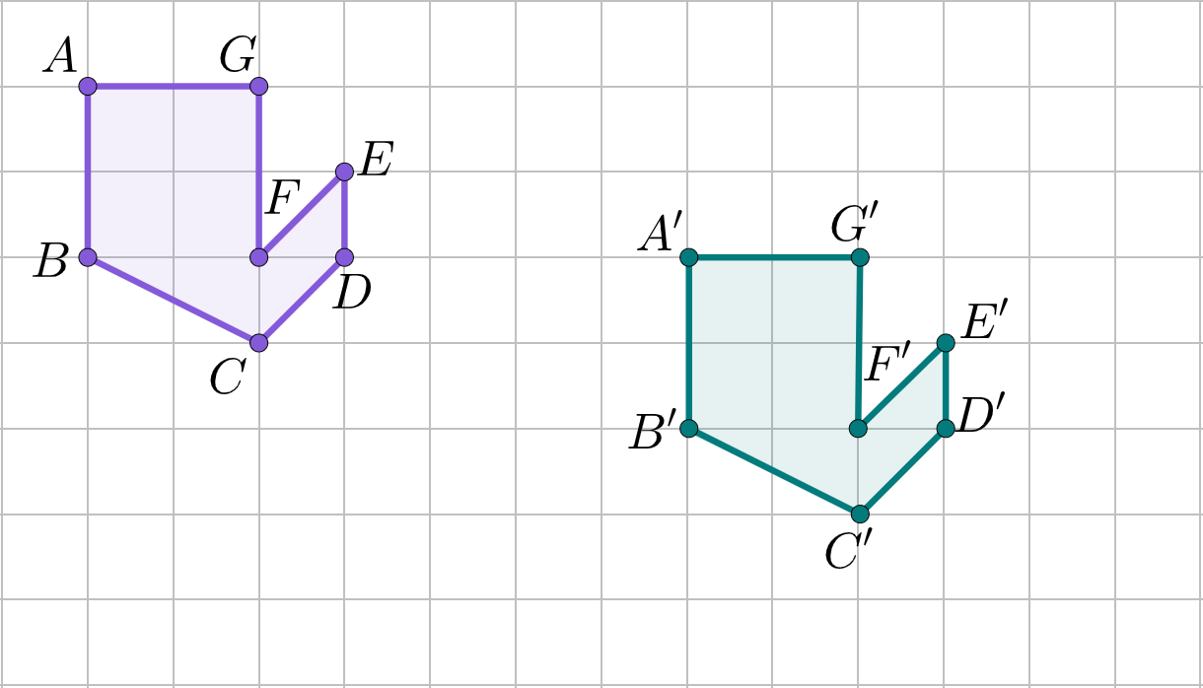
Orientation and position of the image
A translation has taken place where do the other vertices need to be?

Slide 25
Orientation and position of the image
The vertex label doesn’t matter in a translation.
The position of the image is all that matters.
If the labels are not in the same position as the object, then a translation has not taken place.

Slide 26
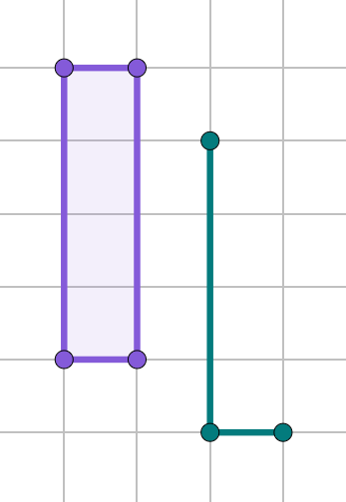
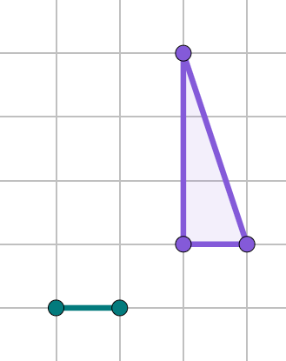
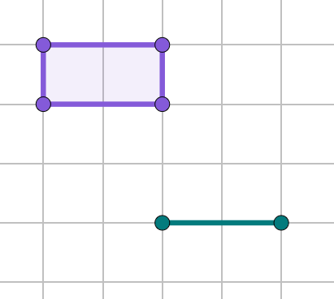
Orientation and position of the image
Complete the shape, so that a translation has taken place.
b)
c)
A
D
Q
Y
X
A′
Z
W
C
R
P
Z′
W′
B
B′
C′
R′
P′

Slide 27

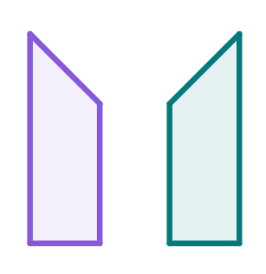

Orientation and position of the image
Identify which property of the image is incorrect for it to be a translation.
b)
c)

Slide 28
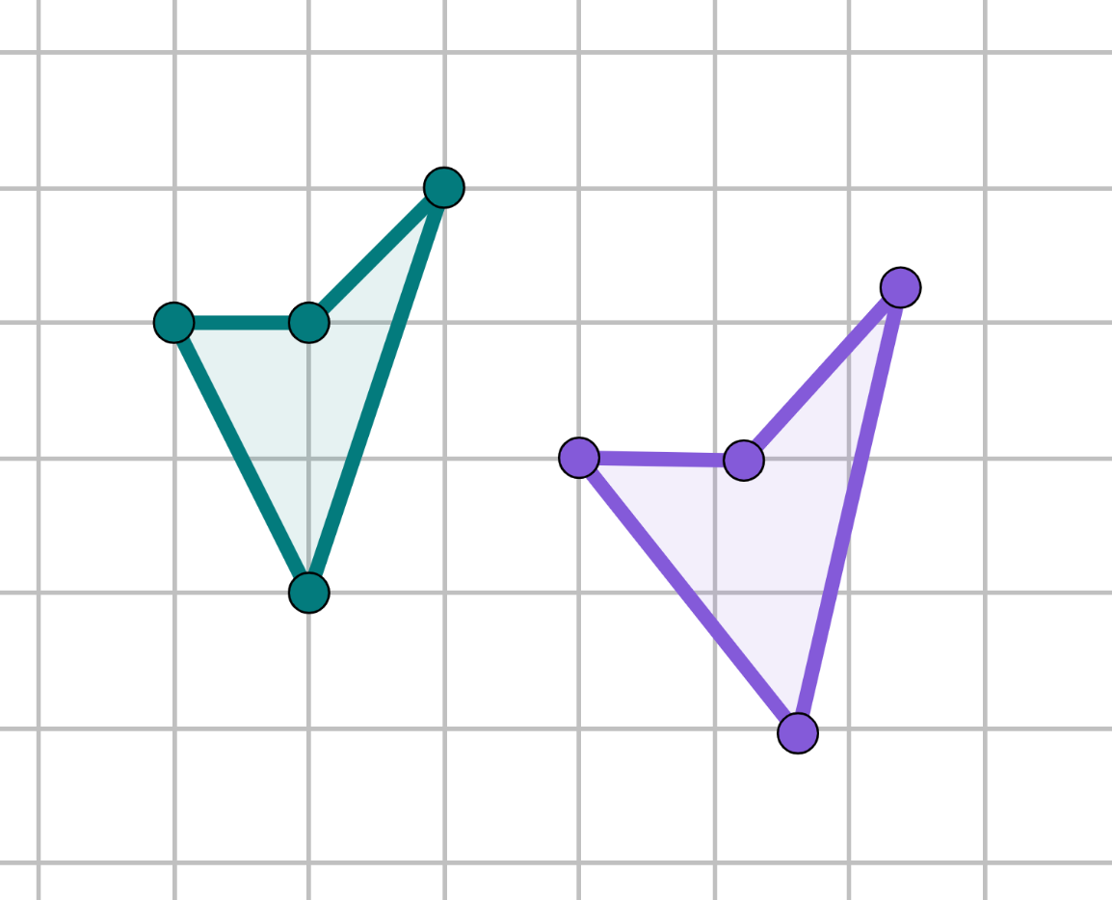
Orientation and position of the image
Complete the table and decide whether a translation has taken place.
Property | Changed - yes/no?
Lengths
Angles
Mirrored
Orientation
Position

Slide 29
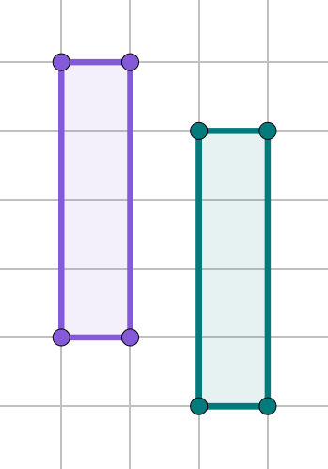
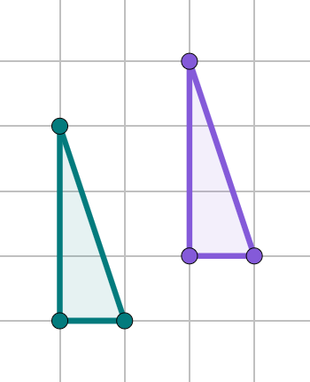
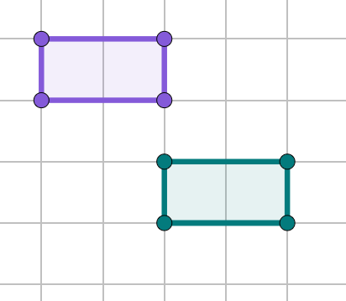
Orientation and position of the image
Complete the shape, so that a translation has taken place.
b)
c)
A
D
Q
Y
X
A′
D′
Q′
Z
W
Y′
X′
R
P
Z′
W′
B
C
B′
C′
R′
P′

Slide 30
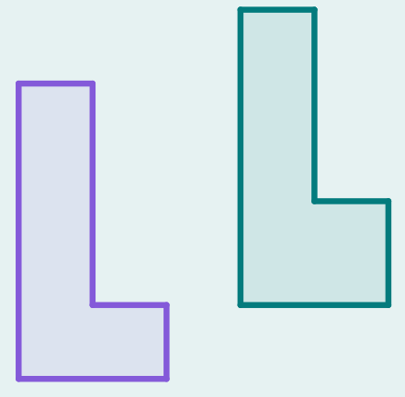
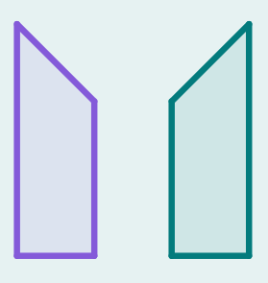

Orientation and position of the image
Identify which property of the image is incorrect for it to be a translation.
b)
c)
mirrored
lengths
orientation

Slide 31
Orientation and position of the image
Complete the table and decide whether a translation has taken place.
Property | Changed - yes/no?
Lengths | yes
Angles | yes
Mirrored | no
Orientation | no
Position | yes
It is not a translation.

Slide 32
Introduction to translation
A translation is a transformation in which every point of a shape moves the same distance in the same direction.
The image is congruent to the object, so its lengths and angles do not change.
The image has the same orientation as the object.
The only property of the object that changes in a translation is its position.

Slide 33

© Oak National Academy 2023.
Produced in partnership with Mathematics in Education and Industry.
Licensed on the Open Government Licence v3.0, except where otherwise stated. See Oak terms and conditions.

